Slide 1
PROCESS AND POWER
IN INTERNET GOVERNANCE
REFLECTIONS ON THE IANA TRANSITION
PRESENTATION AT RIPE 72
26 MAY 2016, 0900-1030
Jan Aart Scholte
University of Gothenburg

Slide 2
QUESTION
What does the currently unfolding IANA transition reveal about the workings of governance around critical Internet resources?

Slide 3
OUTLINE
the IANA transition in summary
institutional processes in the IANA transition
structural power in the IANA transition
lessons: the promises to build on
lessons: the perils to be overcome

Slide 4
IANA TRANSITION CHRONOLOGY
NTIA announcement, 14 March 2014
ICG process, July 2014-October 2015
CCWG-Accountability, Nov 2015-March 2016
USG review, March 2016-??
RZMA talks, August 2015-??
Transition complete, 30 September 2016 (?)

Slide 5
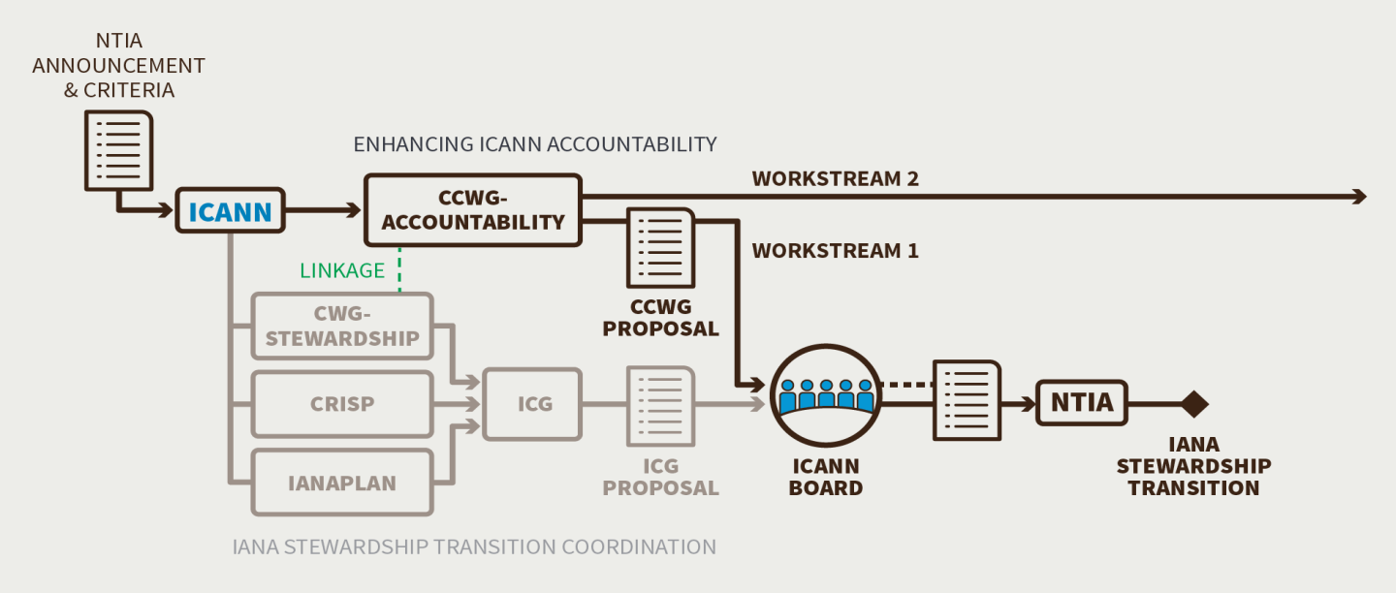

Slide 6
POLICY BY POLYCENTRIC NETWORK
transscalarity (interlinking global, regional, national and local agencies)
transsectorality (interlinking official, commercial and civil society actors)
diffusion (scattered over many sites)
fluidity (highly changeable over time)

Slide 7
POLICY BY POLYCENTRIC NETWORK
overlapping mandates (multiple agencies claim competence over the same issues)
ambiguous hierarchies (often unclear lines of command between agencies)
the absence of a final arbiter

Slide 8
INSTITUTIONAL POLYCENTRISM
IN THE IANA TRANSITION
 | PUBLIC | PRIVATE and HYBRID
GLOBAL | GAC, ITU, UN/WSIS+10 | ICANN, IETF, NRO, IAB, gTLD registries, ISOC, IGF, Verisign, W3C
REGIONAL | AU, EU, HLIG | RIRs, regional ccTLD associations, EuroDIG, regional IGFs
COUNTRY | NTIA, other state ministries and coordination bodies, US Congress, some ccTLDs | some ccTLD registries, national IGFs
LOCAL |  | universities

Slide 9
STRUCTURED POLYCENTRISM
’ORGANISED CHAOS’
myths of horizontality and ’bottom-up’ processes
geopolitical structures
social structures
cultural structures
power in polycentric networks as a function of intersecting hierarchies

Slide 10
POLYCENTRIC GOVERNANCE
PROMISES
richness (of information, insight, experience)
creativity
speed
adaptability

Slide 11
POLYCENTRIC GOVERNANCE
PROMISES
responsiveness: addressing issues
responsiveness: forum shopping
relevance and quality
democracy

Slide 12
POLYCENTRIC GOVERNANCE
CHALLENGES
retooling
navigating the labyrinths
negotiating cultural diversity
living with incoherence and uncertainty
limiting duplication and inefficiency

Slide 13
POLYCENTRIC GOVERNANCE
CHALLENGES
securing compliance
checking special-interest capture
obtaining accountability (of governance institutions)
obtaining accountability (of stakeholder representatives)
fostering access and turnover

Slide 14
MAIN TAKE-AWAY
The novelties of Internet governance give cause for celebration and worry.
Embrace multistakeholderism, but do not do so uncritically.

Slide 15
WHAT TO DO
take care to locate oneself within wider polycentric policymaking networks
be ever ready to renovate policy processes in order to maximise promises and minimise perils
monitor and where necessary resist structural power, particularly where it generates arbitrary unfairness

